Slide 1

8020fit.ai sprint 1
FITNESS
FITNESS
FITNESS
FITNESS
FITNESS
FITNESS
FITNESS
Presented by Team fitforce

Slide 2

AGENDA
Feedback adjustments
Problem statement
Project description
Working agreement
Personas
Minimum viable product
technologies
Algorithms
Diagrams
Product Backlog
Sprint 1 backlog
Metrics
Retrospective
Sprint 2 planning
Project demo (App & api Screenshots)
GitHub link
Live app demo
AGENDA
AGENDA

Slide 3

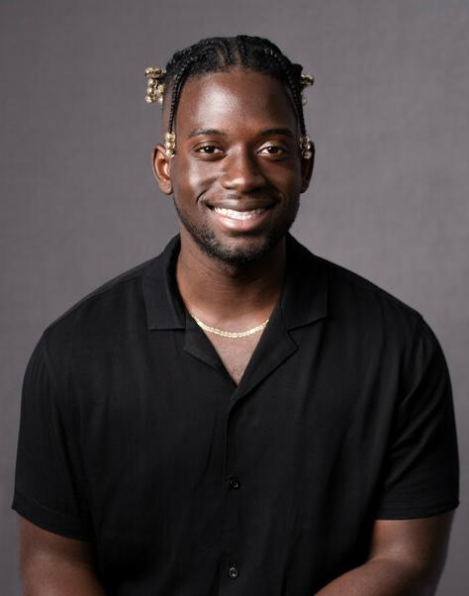
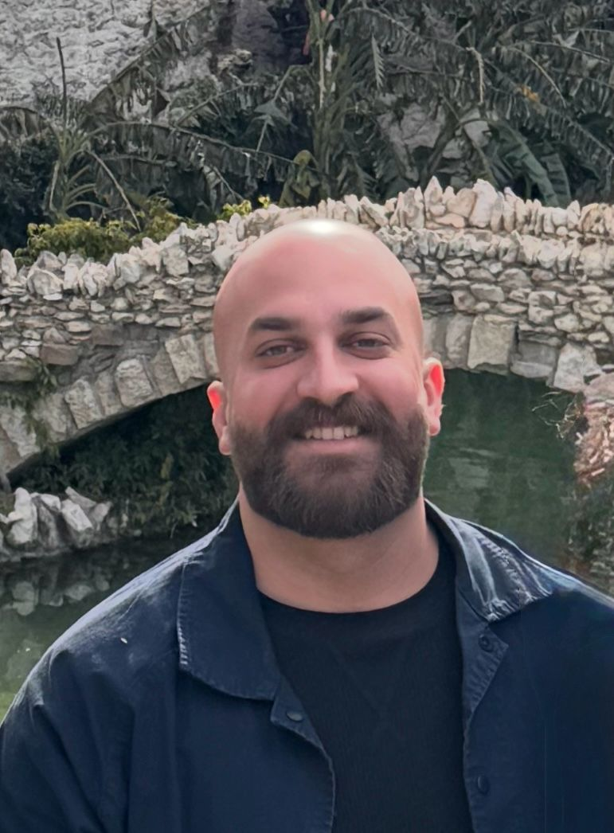
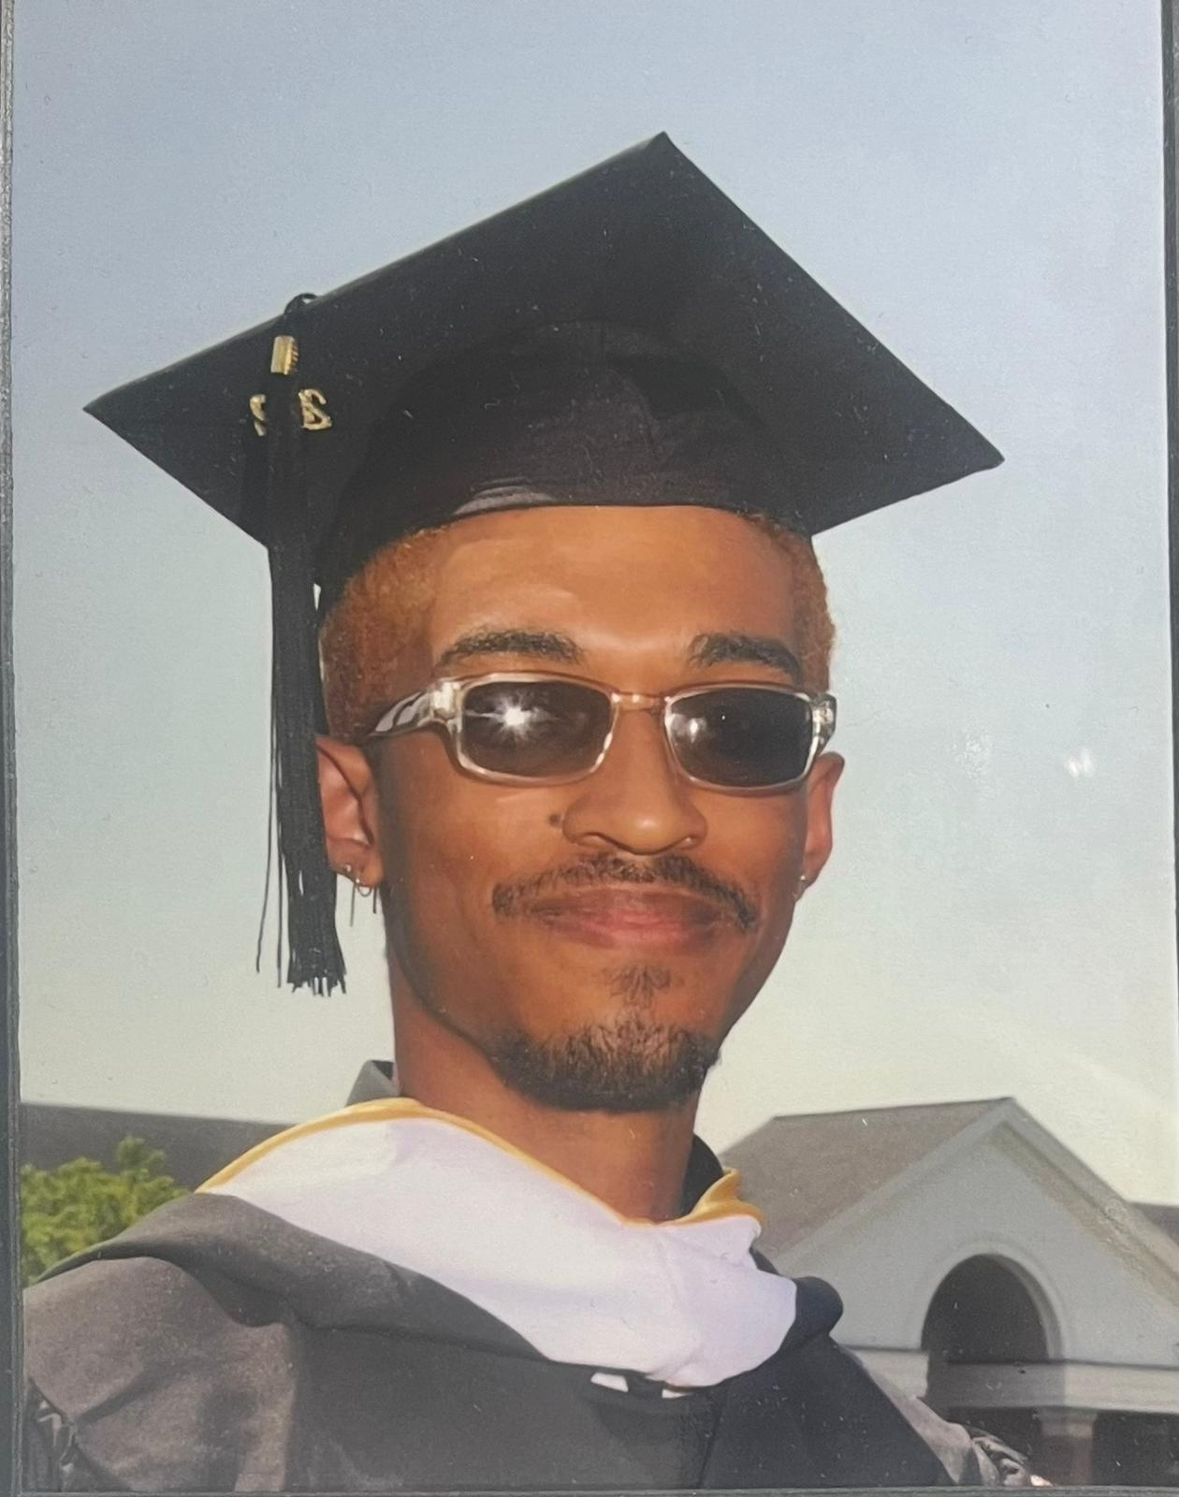
MEET the fitforce team
Adrian egasan
Yaw Mensah
Mustafa al-tameemi
Miguel lugo
Front End Developer
Back End Developer
Back End Developer
Front End Developer

Slide 4

MEET THE FITFORCE TEAM
ROHAN PATEL
Back End Developer

Slide 5
ADJUSTMENTS OF FEEDBACK
We changed one the “Bank End Developer” from the Roles And Responsibilities slide to “Back End Developer” as this was a spelling mistake
We deleted the Project Tracker
We changed the Persona slides to match the presentation slides

Slide 6

Problem
problem
Problem
People fail to achieve their nutrition and fitness goals due to overcomplicated health/fitness apps, lack of education, hectic lifestyles, expensive personal trainers & gym memberships, and misinformation in the nutrition & fitness industries.

Slide 7

Project
8020FIT.AI is a comprehensive webapp deigned to optimize nutrition and fitness tracking. End users will take an in-depth quiz on what their fitness goals are as well as body measurements and goal body measurements. The AI will then create custom tailored workouts, and meal plans for the user. End users will also be able to log their workouts and macros to see if they’re on track.
Project
Project

Slide 8
MVP (Minimum Viable Product)
User Profile and Registration
a. Obtain user data via onboarding quiz: age, height, weight, fitness goals/experiences, workout preferences
Workout Regiment/Recommendation – AI Generation
a. Use machine learning to adjust workout plan based on progress and/or user feedback
b. Dynamically recommend workout based on available equipment or alternative methods
Maintain user friendly webapp
AI Chatbot
a. Develop AI chat bot that can answer FAQs based on fitness

Slide 9
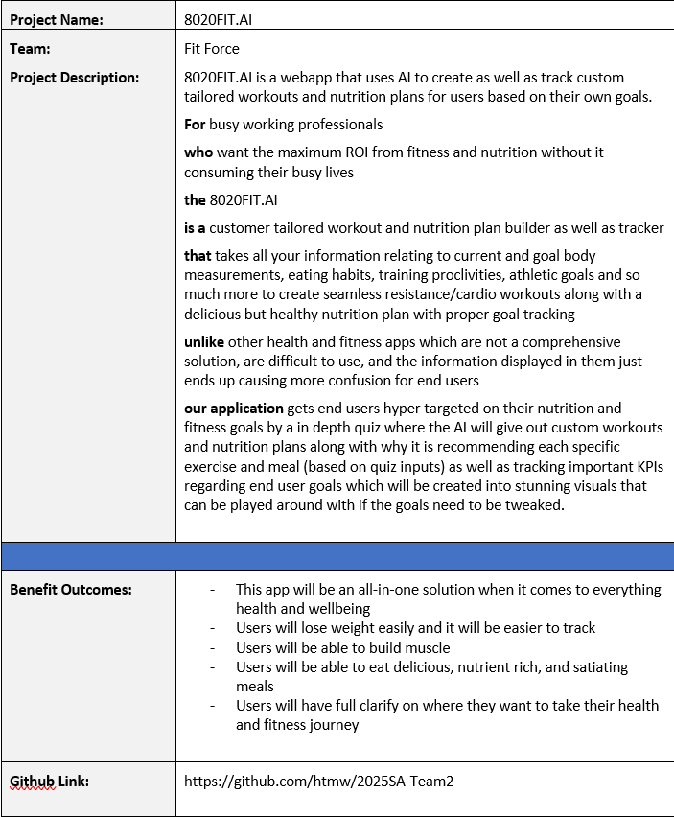

Slide 10
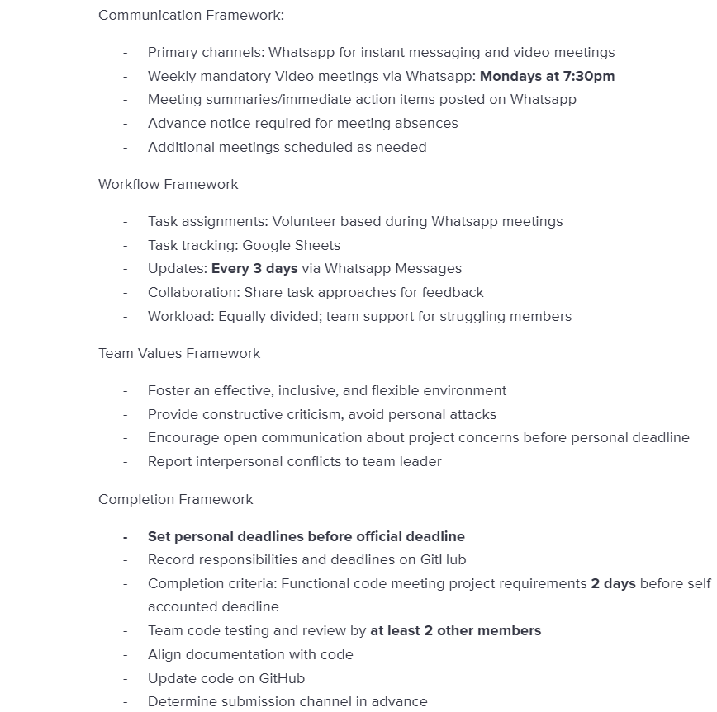
Overview
WORKING AGREEMENT

Slide 11

Working
professional
persona
Age: 28
Occupation: Marketing Manager
Fitness Level: Beginner
Technology Comfort: Moderate
Goals: She wants to increase energy levels and lose weight, prefers quick and efficient workouts.
Challenges: limited time due to a demanding job, limited knowledge about effective workout routines, hard to stay motivated.

Slide 12

college
student
persona
Age: 22
Occupation: Student
Fitness Level: Intermediate
Technology Comfort: High
Goals: Build muscle and increase strength, trying new workout routines.
Challenges: Limited equipment availability at his gym so he prefers body weight and minimal equipment exercises, needs a variety of workouts to prevent boredom

Slide 13

Middle aged
mom
persona
Age: 38
Occupation: Stay at home parent
Fitness Level: Beginner
Technology Comfort: Low to moderate
Goals: Maintaining health and boosting energy for her family, prefers low-impact exercises that can fit around her children’s schedules
Challenges: Finds it challenging to set aside dedicated time for workout, overwhelmed by complex fitness apps, needs workouts that are gentle but effective, due to past injuries

Slide 14
Technologies
Technologies
Technologies
Programming languages
Tools
Back End: Typescript
Front End: React, Typescript
Visual Studio Code
AWS Amplify

Slide 15
Technologies
Technologies
Technologies
database
API
AWS DynamoDB
Workout Manager (wger) API

Slide 16
algorithms
algorithms
algorithms
Arithmetic
Decision tree
Restful data fetching
Provides accurate calculation of Body Mass Index (BMI) along with other crucial metrics
Creates custom tailored workout recommendations for the end user
Allows us to get data from a local or remote server via Workout Manager (wger) API
Notes:
What went well:
Quick decision: team members quickly established project idea as well as roles and responsibilities
Flexibility: team members were open to scheduling more meetings than necessary to get in alignment with each other for the project
Clarity: ideas started coming together as soon as the team started executing on respective action items, structuring the information on the slides, and getting clear on the working agreement
What can be improved:
Late planning: led to a rushed feeling, we did not know much about the project until January 25th when we could have started January 21st
Meeting structure: everyone needs to be clear on their own action items as well as other group members action items to be in sync
Communication: proactively letting the group know what they did on the project so other group members quickly test and verify it
What will we implement moving forward:
Implement a framework for our meetings moving forward where we know what exactly each of us is doing in the project at any moment in time
Team members will be asked to use the tracker to give themselves deadlines as well as check when tasks are complete
Update each other once every three days to see where everyone is with their responsibilities

Slide 17
algorithms
algorithms
algorithms
Real time data sync
Progress prediction
Authentication/access control
To keep frontend data in sync with backend
To predict user performance trends
Secures API and data access using AWS Amplify Auth (Cognito) with role-based access control
Notes:
What went well:
Quick decision: team members quickly established project idea as well as roles and responsibilities
Flexibility: team members were open to scheduling more meetings than necessary to get in alignment with each other for the project
Clarity: ideas started coming together as soon as the team started executing on respective action items, structuring the information on the slides, and getting clear on the working agreement
What can be improved:
Late planning: led to a rushed feeling, we did not know much about the project until January 25th when we could have started January 21st
Meeting structure: everyone needs to be clear on their own action items as well as other group members action items to be in sync
Communication: proactively letting the group know what they did on the project so other group members quickly test and verify it
What will we implement moving forward:
Implement a framework for our meetings moving forward where we know what exactly each of us is doing in the project at any moment in time
Team members will be asked to use the tracker to give themselves deadlines as well as check when tasks are complete
Update each other once every three days to see where everyone is with their responsibilities

Slide 18

Schedule
Mondays @ 7:30pm
weekly
spr 000
January 25 – February 10
Schedule
spr 001
February 10 – March 10
Schedule
spr 002
March 10 – April 7
Spr 003
April 7 – May 5

Slide 19
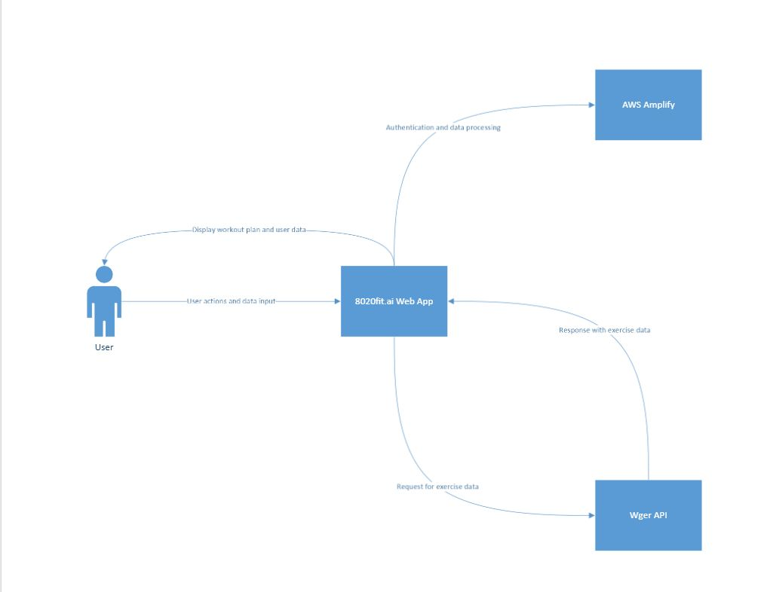
Context
Diagram

Slide 20
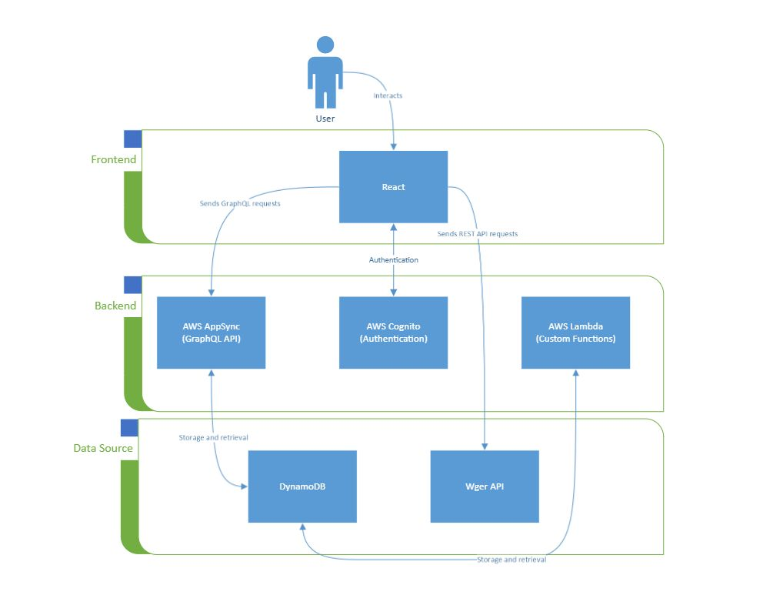
Architecture
Diagram

Slide 21
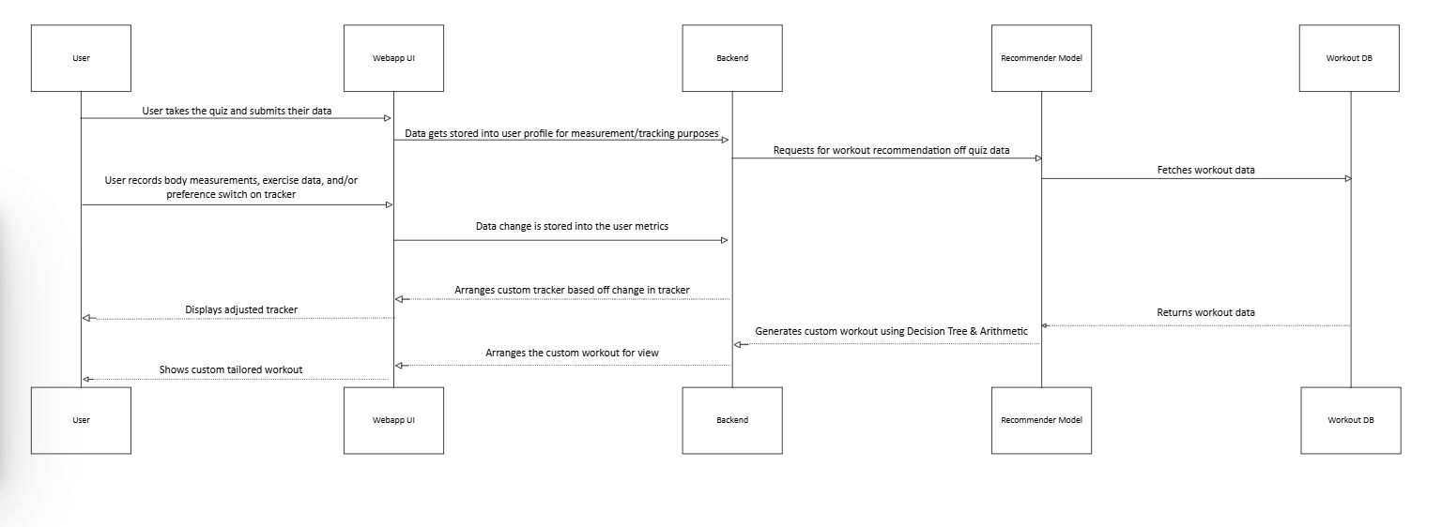
Sequence diagram

Slide 22
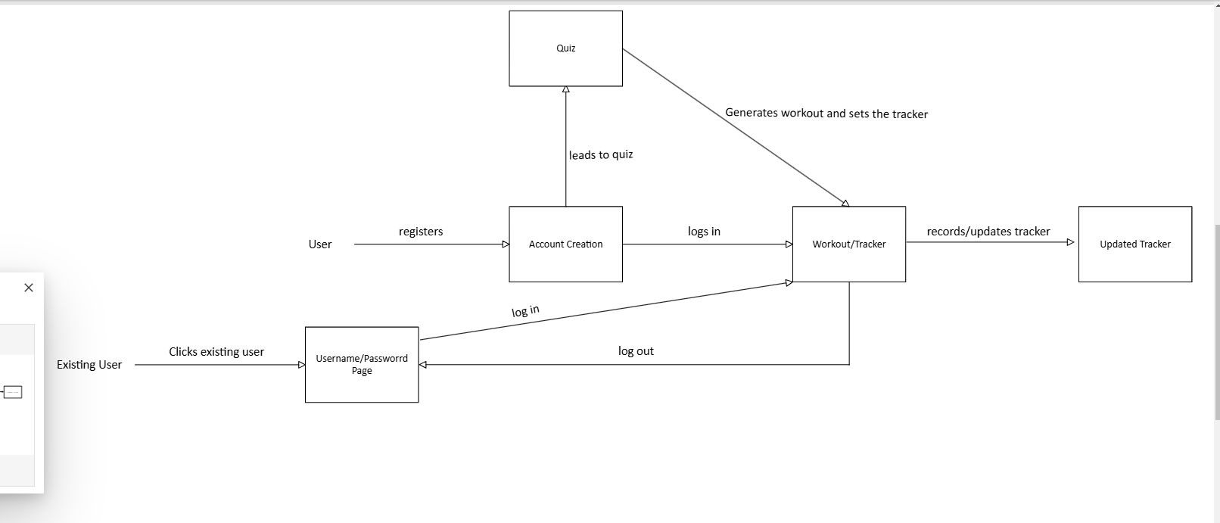
state diagram

Slide 23
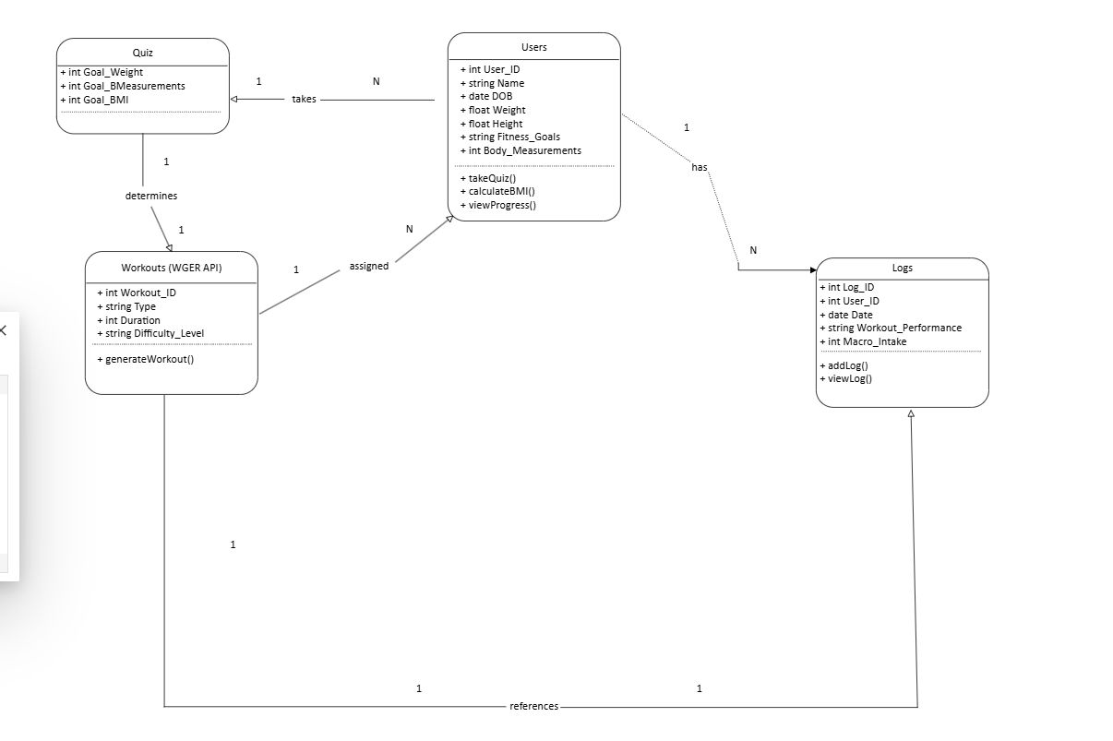
Class diagram

Slide 24
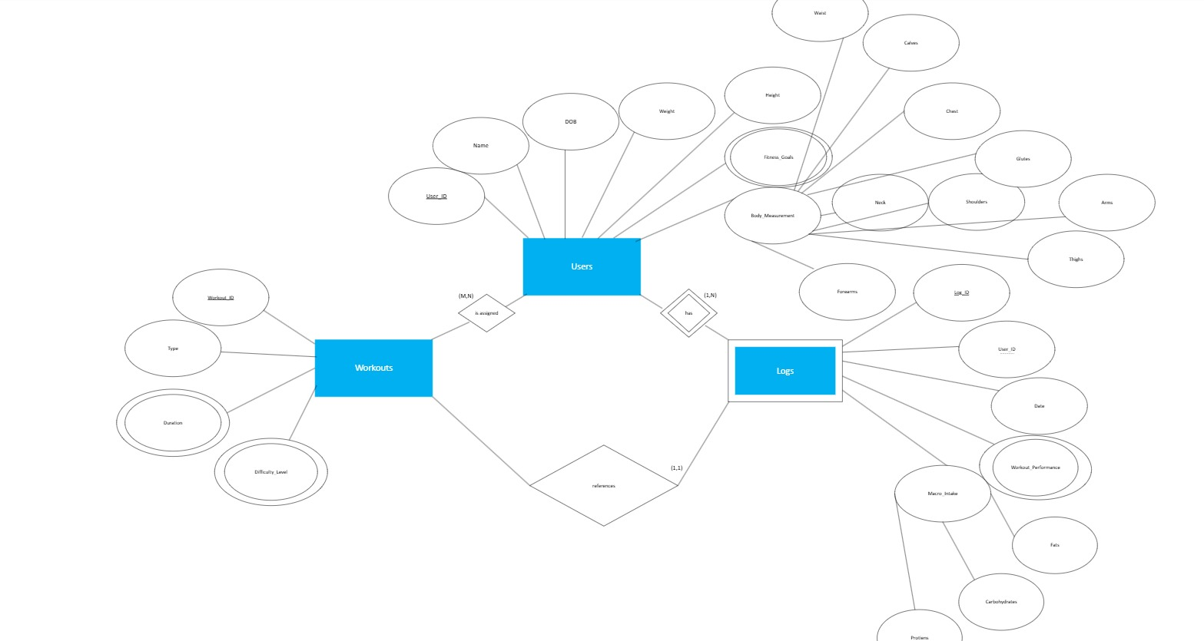
er diagram

Slide 25
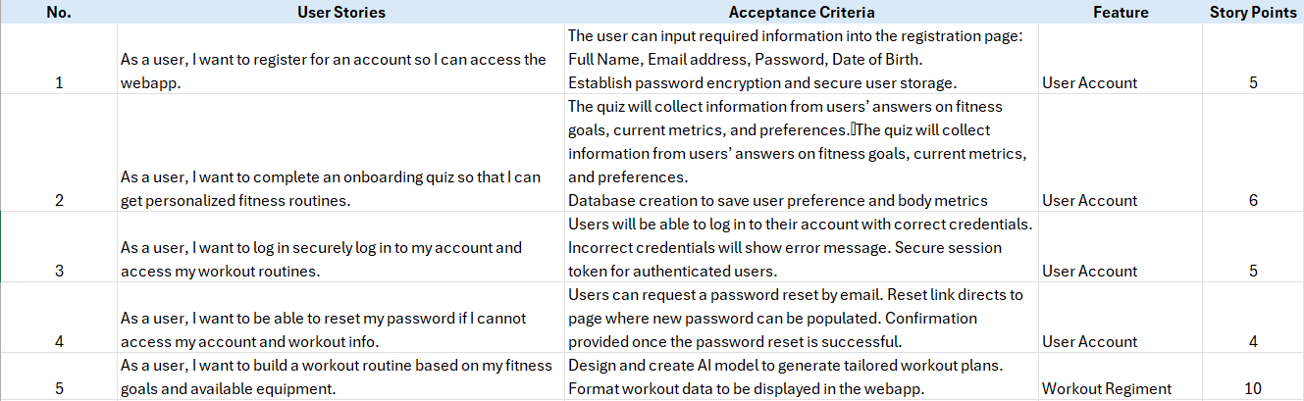
Product Backlog

Slide 26
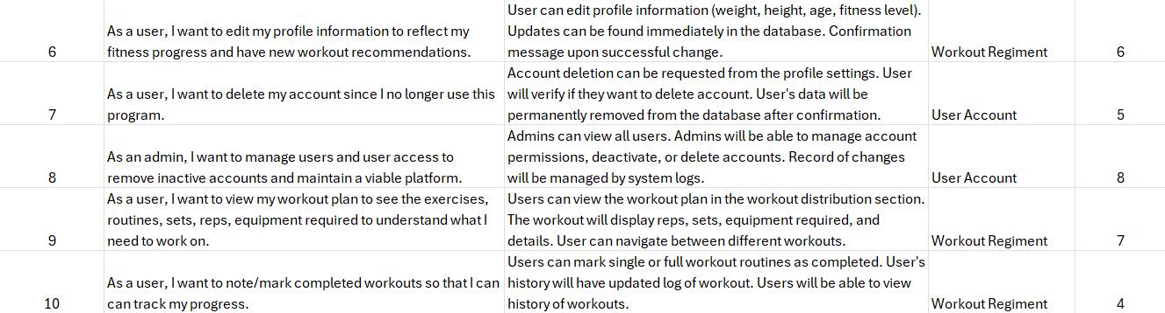
Product Backlog (con’t)

Slide 27
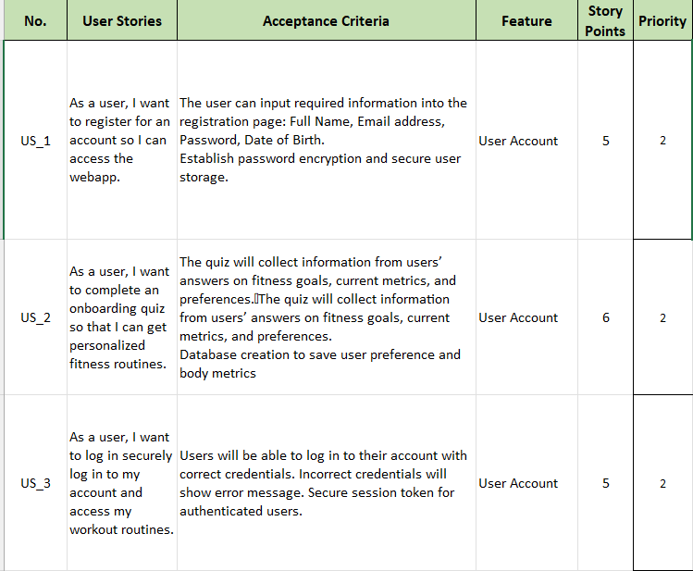
Sprint 1 Stories

Slide 28
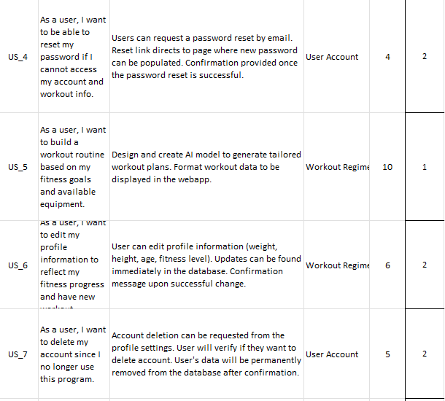
Sprint 1 Stories (con’t)

Slide 29
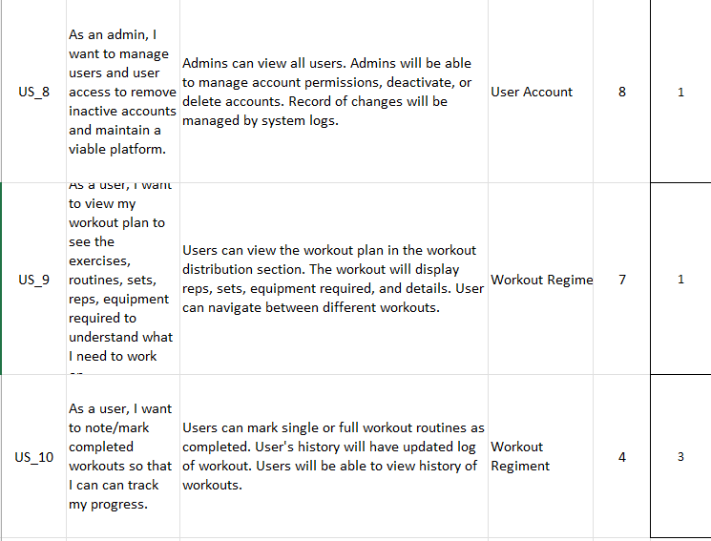
Sprint 1 Stories (con’t)

Slide 30
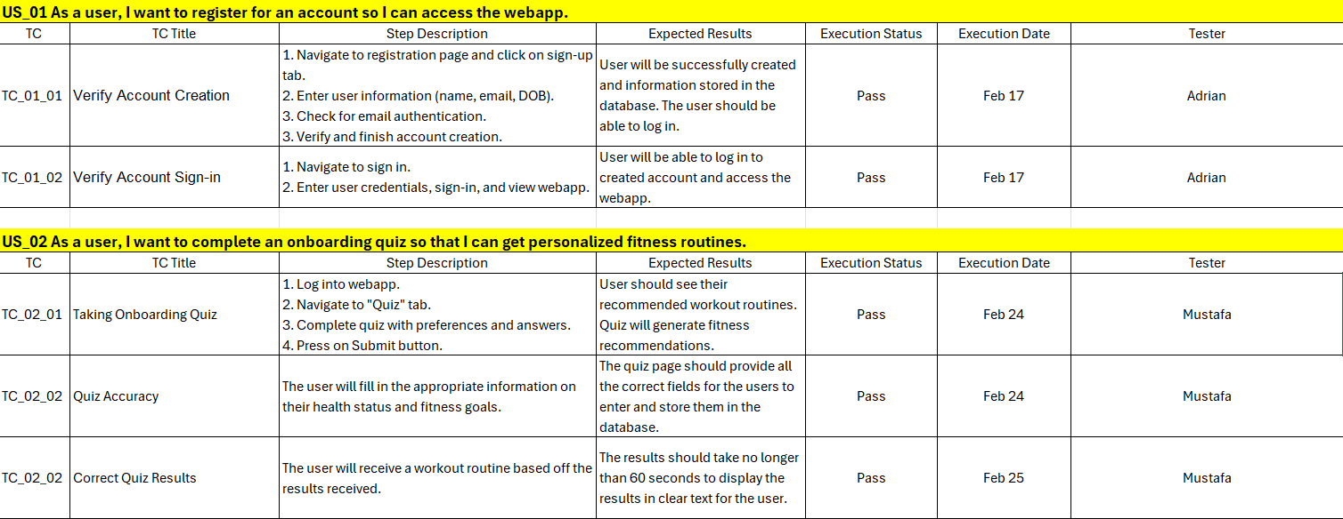
Sprint 1 Test Case

Slide 31
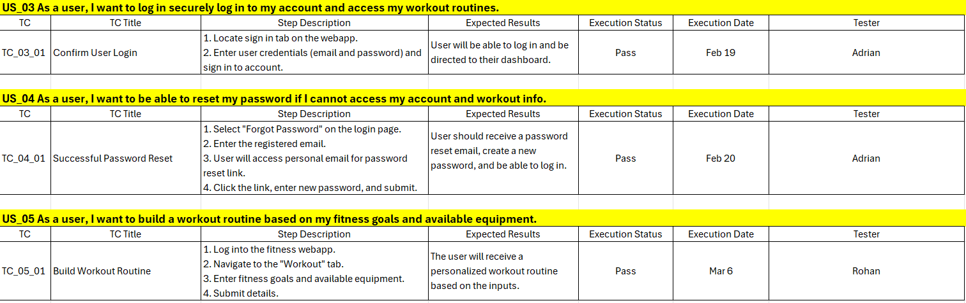
Sprint 1 Test Case

Slide 32
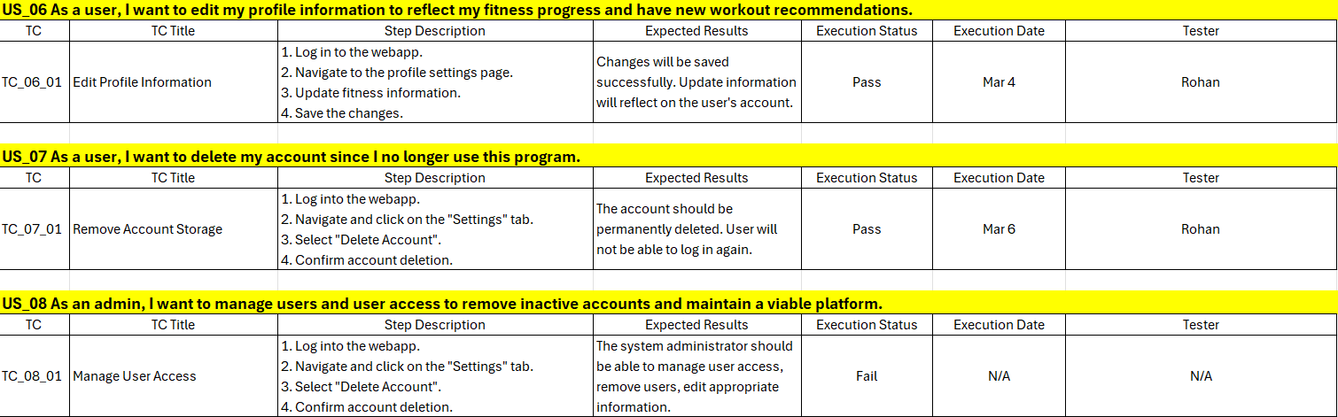
Sprint 1 Test Case

Slide 33
Sprint 1 Test Case

Slide 34
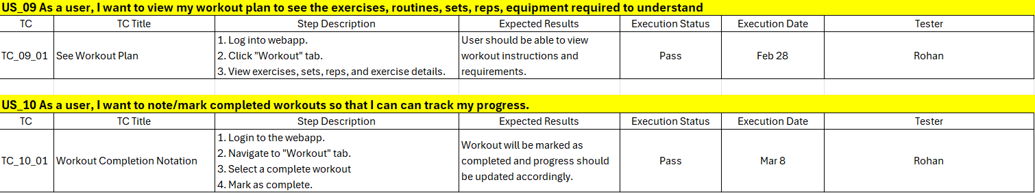
Sprint 1 Test Case

Slide 35
Sprint 1 Stories Completed and Not
US_ID | User Stories | Completed Date | Story Points | Completed
US_1 | As a user, I want to register for an account so I can access the webapp. | Feb 17 | 5 | 5
 | Set up React + VITE front-end server |  | 1 | 1
 | Set up AWS Amplify and DynamoDB Backend |  | 1 | 1
 | Finalize design for homepage |  | 1 | 1
 | Integrate the front-end and back-end |  | 2 | 2
US_2 | As a user, I want to complete an onboarding quiz so that I can get personalized fitness routines. | Feb 24 | 3 | 3
 | Access to the quiz |  | 1 | 1
 | Taking the quiz |  | 1 | 1
 | Quiz Results |  | 1 | 1

Slide 36
Sprint 1 Stories Completed and Not
US_ID | User Stories | Completed Date | Story Points | Completed
US_3 | As a user, I want to log in securely log in to my account and access my workout routines. | Feb 19 | 2 | 2
 | Proper sign in screen |  | 1 | 1
 | A regular account should have access to all features of our app |  | 1 | 1
US_4 | As a user, I want to be able to reset my password if I cannot access my account and workout info. | Feb 20 | 2 | 2
 | Get to the log in screen |  | 1 | 1
 | Go through the forget my password link for recovery |  | 1 | 1

Slide 37
Sprint 1 Stories Completed and Not
US_ID | User Stories | Completed Date | Story Points | Completed
US_5 | As a user, I want to build a workout routine based on my fitness goals and available equipment. | Mar 6 | 10 | 10
 | Retrieve quiz results |  | 3 | 3
 | Match up the results with the WGER api |  | 4 | 4
 | Ensure it displays properly |  | 3 | 3
US_6 | As a user, I want to edit my profile information to reflect my fitness progress and have new workout recommendations. | Mar 4 | 3 | 3
 | Access the account |  | 1 | 1
 | Update the profile information |  | 1 | 1
 | Ensure that the results update the workout recommendations |  | 1 | 1

Slide 38
Sprint 1 Stories Completed and Not
US_ID | User Stories | Completed Date | Story Points | Completed
US_7 | As a user, I want to delete my account since I no longer use this program. | Mar 6 | 2 | 2
 | Sign into to account you wish to delete |  | 1 | 1
 | Delete account under settings |  | 1 | 1
US_8 | As an admin, I want to manage users and user access to remove inactive accounts and maintain a viable platform. | N/A | 3 | 0
 | Sign in to an admin account |  | 1 | 0
 | View the number of connected accounts |  | 1 | 0
 | Remove any inactive accounts |  | 1 | 0

Slide 39
Sprint 1 Stories Completed and Not
US_ID | User Stories | Completed Date | Story Points | Completed
US_9 | As a user, I want to view my workout plan to see the exercises, routines, sets, reps, equipment required to understand what I need to work on. | Feb 28 | 5 | 5
 | Sign in to an account |  | 4 | 4
 | Go to Profile to view workouts. |  | 1 | 1
US_10 | As a user, I want to note/mark completed workouts so that I can track my progress. | Mar 8 | 3 | 3
 | Get access to your profile |  | 1 | 1
 | Mark a workout as complete |  | 1 | 1
 | Ensure that the completed workouts are updated for each account |  | 1 | 1

Slide 40
Team Velocity
Sprint 1 Velocity
Total Story Points: 61
Velocity: 53 story points completed.

Slide 41
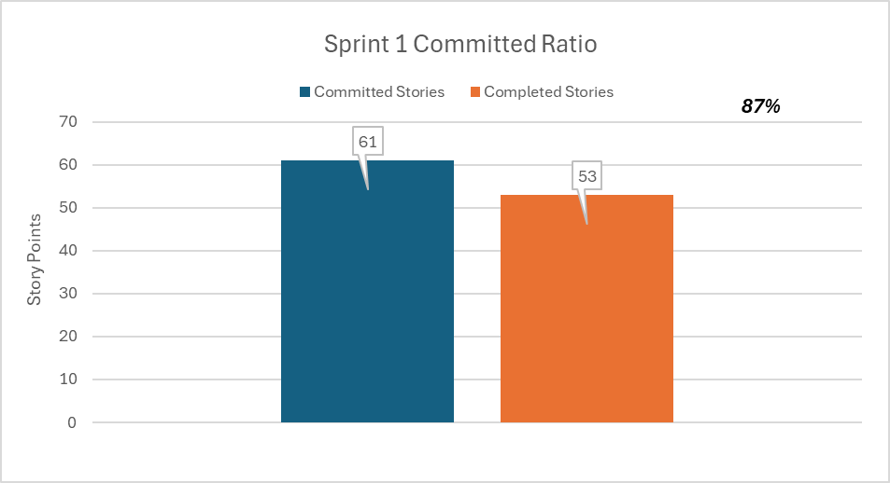
Committed Ratio

Slide 42
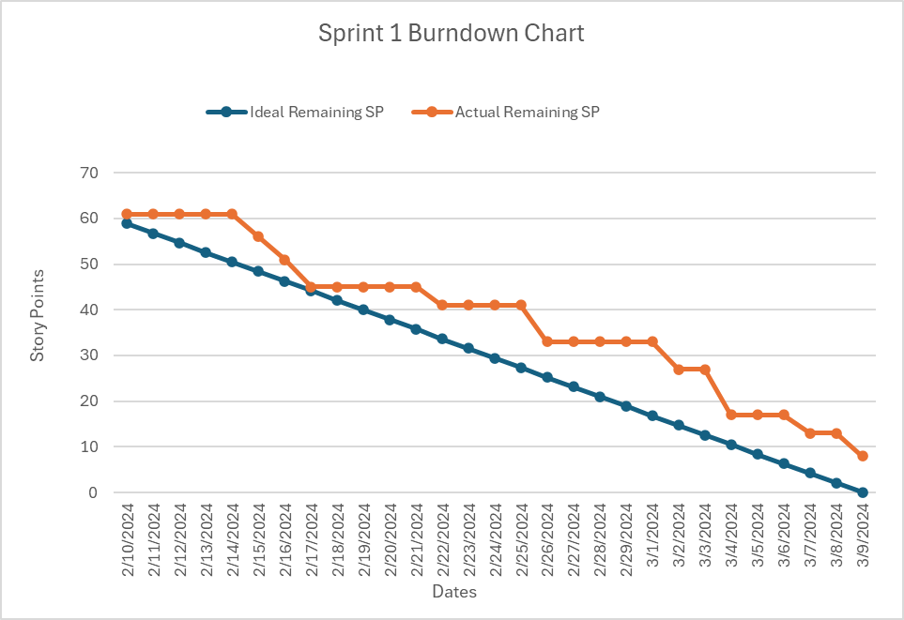
Sprint 1 Burndown Chart

Slide 43
Retrospective
Retrospective
retrospective
Good
Bad
Apply
Flexibility for group meetings
Assigned roles and responsibilities based off strengths
We were good at looking from a macro perspective on webapp features
We had a hard time breaking down steps to build out the model
We did not have a good predication of how long each feature was going to take
We were coding in silos and decided last minute on who’s code to work off
Be more diligent during Sprint 2 recording when breaking down features
We will work off each other’s code more
Daily updates on what everyone in the group is doing

Slide 44
Sprint 2 Planning
US_ID | User Stories | Acceptance Criteria | Feature | Story Points
US_1 | As a user, I want to use an AI chat feature. | The app will allow the user to communicate with an AI chat bot in order to gain insight health and workouts while also answering questions the user might have about proper exercise. | Artificial Intelligence | 15
US_2 | As an admin, I want to make the webapp more user friendly. | The app will display clear text and buttons for the users. | Webapp | 10
 | User Stories Carry Over from Sprint 1
US_8 | As an admin, I want to manage users and user access to remove inactive accounts and maintain a viable platform. | Admins can view all users. Admins will be able to manage account permissions, deactivate, or delete accounts. Record of changes will be managed by system logs. | User Account | 3

Slide 45

Screenshot
APP

Slide 46
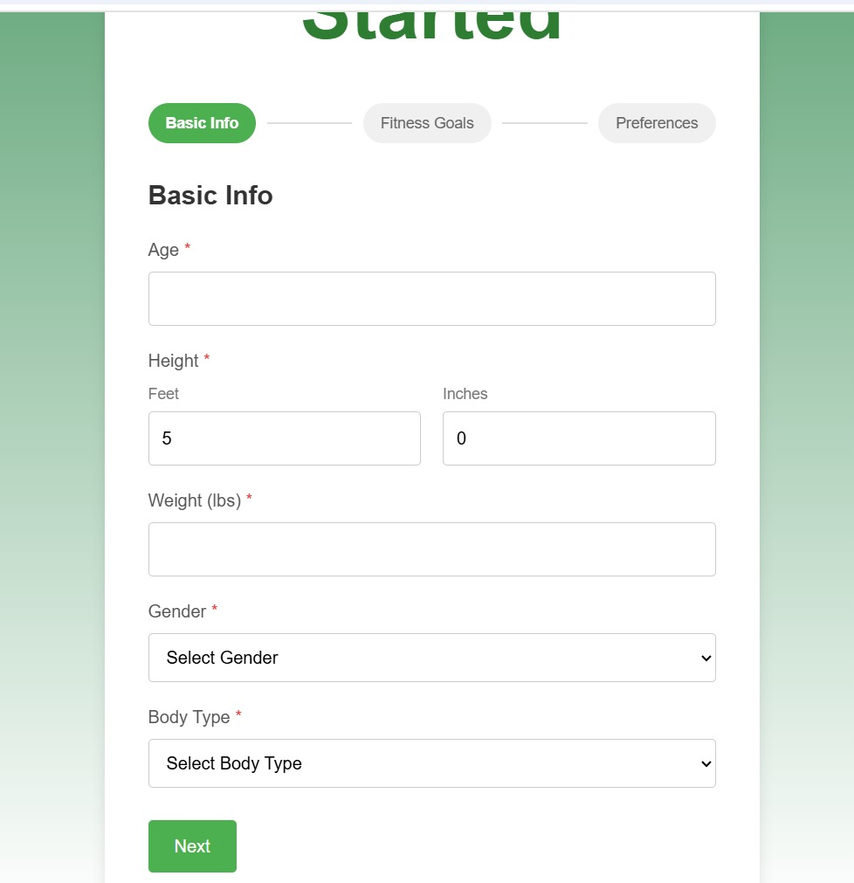
Screenshot
APP

Slide 47
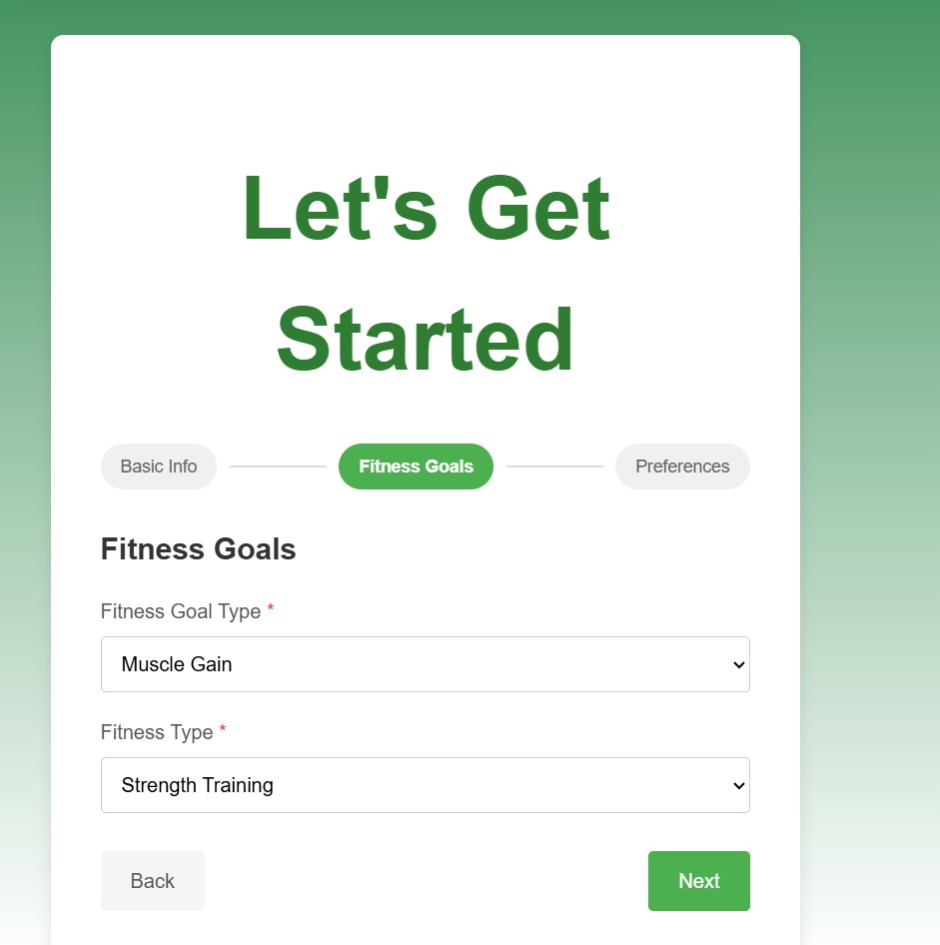
Screenshot
APP

Slide 48
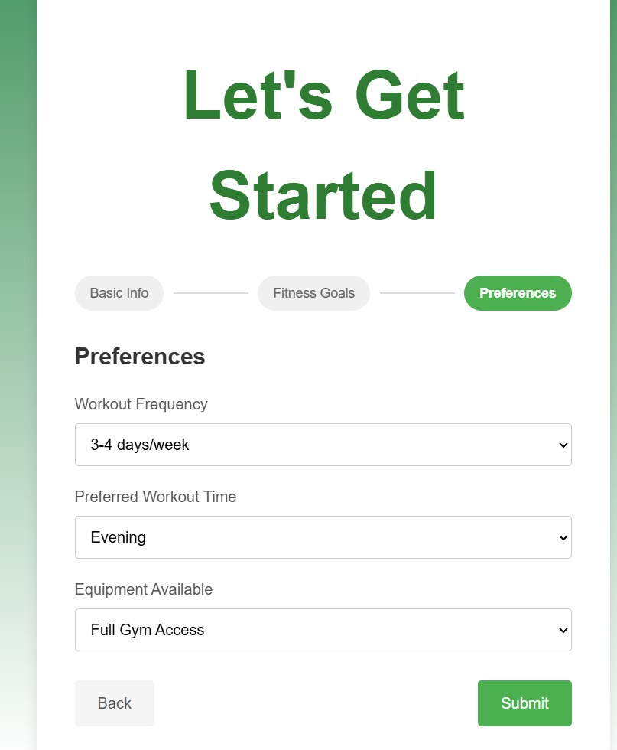
Screenshot
APP

Slide 49
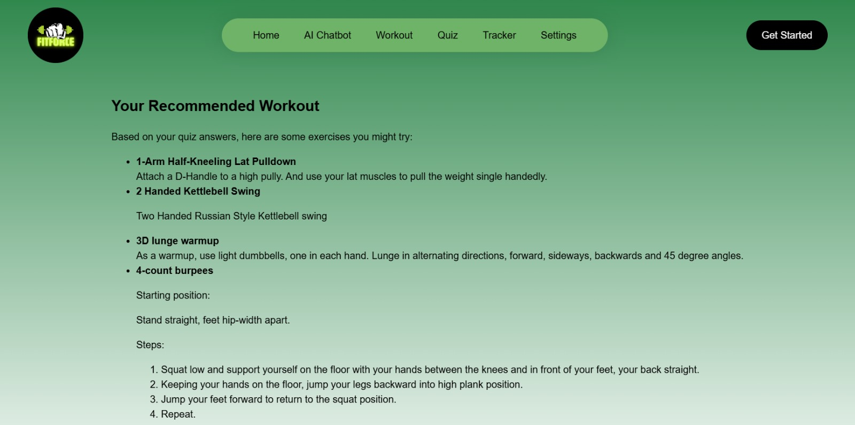
Screenshot
APP

Slide 50
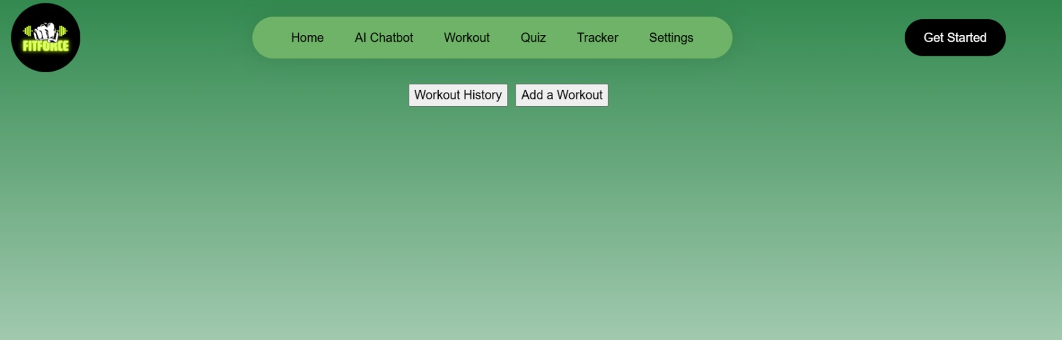
Screenshot
APP

Slide 51

Screenshot
APP

Slide 52
API
API
AWS Amplify API
Wger API
AWS Cognito Authentication API
Type: GraphQL API
Purpose: Manages user onboarding data (storing fitness preferences, goals, etc.).
How it Works:
AWS Amplify automatically generates GraphQL API endpoints to interact with DynamoDB.
Instead of manually sending HTTP GET or POST requests (like in Axios), Amplify abstracts API calls through its client models.
Type: REST API
Purpose: Fetches exercise recommendations based on user preferences.
How it Works:
The app makes GET requests to the Wger API to retrieve exercise data that matches user preferences.
This is done through fetch() in the Workout.tsx component.
Type: Authentication API
Purpose: Manages user authentication (sign-up, login, and identity verification).
How it Works:
AWS Cognito handles authentication and returns a user token after login.
This token is used to authorize API requests to Amplify's backend.
Notes:
What went well:
Quick decision: team members quickly established project idea as well as roles and responsibilities
Flexibility: team members were open to scheduling more meetings than necessary to get in alignment with each other for the project
Clarity: ideas started coming together as soon as the team started executing on respective action items, structuring the information on the slides, and getting clear on the working agreement
What can be improved:
Late planning: led to a rushed feeling, we did not know much about the project until January 25th when we could have started January 21st
Meeting structure: everyone needs to be clear on their own action items as well as other group members action items to be in sync
Communication: proactively letting the group know what they did on the project so other group members quickly test and verify it
What will we implement moving forward:
Implement a framework for our meetings moving forward where we know what exactly each of us is doing in the project at any moment in time
Team members will be asked to use the tracker to give themselves deadlines as well as check when tasks are complete
Update each other once every three days to see where everyone is with their responsibilities

Slide 53
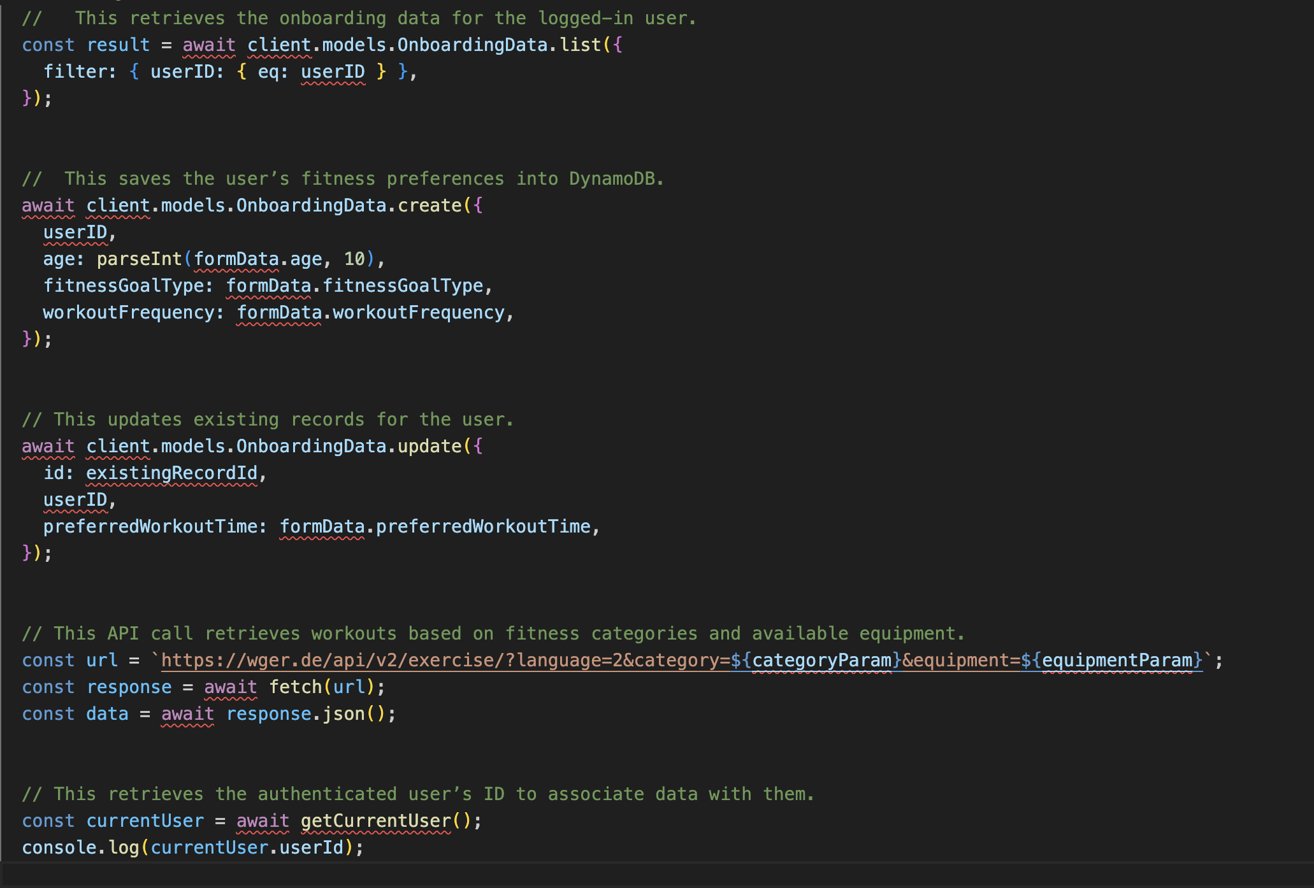
API
API
Notes:
What went well:
Quick decision: team members quickly established project idea as well as roles and responsibilities
Flexibility: team members were open to scheduling more meetings than necessary to get in alignment with each other for the project
Clarity: ideas started coming together as soon as the team started executing on respective action items, structuring the information on the slides, and getting clear on the working agreement
What can be improved:
Late planning: led to a rushed feeling, we did not know much about the project until January 25th when we could have started January 21st
Meeting structure: everyone needs to be clear on their own action items as well as other group members action items to be in sync
Communication: proactively letting the group know what they did on the project so other group members quickly test and verify it
What will we implement moving forward:
Implement a framework for our meetings moving forward where we know what exactly each of us is doing in the project at any moment in time
Team members will be asked to use the tracker to give themselves deadlines as well as check when tasks are complete
Update each other once every three days to see where everyone is with their responsibilities

Slide 54

THANK YOU
THANK
YOU
THANK
YOU
THANK
YOU
THANK
https://github.com/egasan21/8020fit

